Slide 1

COMPUTER NETWORKING
LAB 3

Slide 2
Static Routing

Slide 3
OBJECTIVES
Configuration of a static route using an interface and an IP address as the next hop.
Verification of static route operation.
Implementation of the interconnection between a local and external network using a default route.
Configuration of a backup static route on a router.

Slide 4
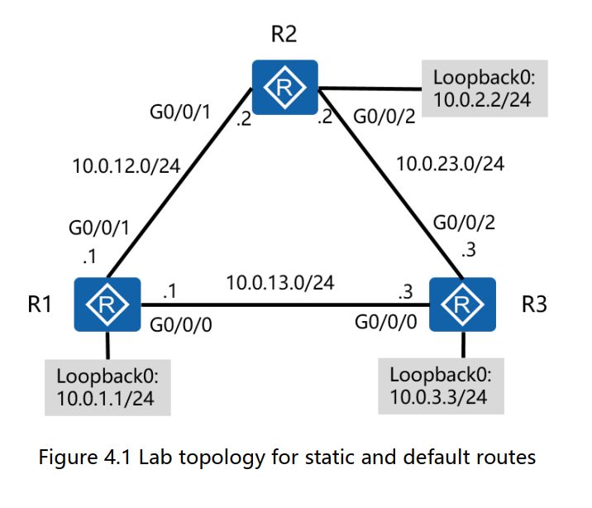
Topology

Slide 5
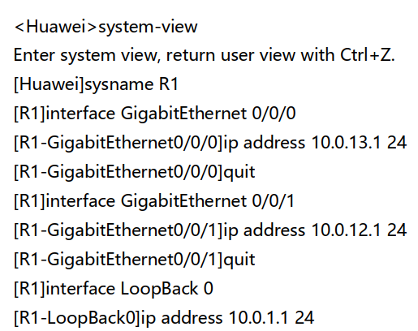
Perform basic system and
IP address configuration
Configure device name and IP addresses for R1, R2, and R3

Slide 6
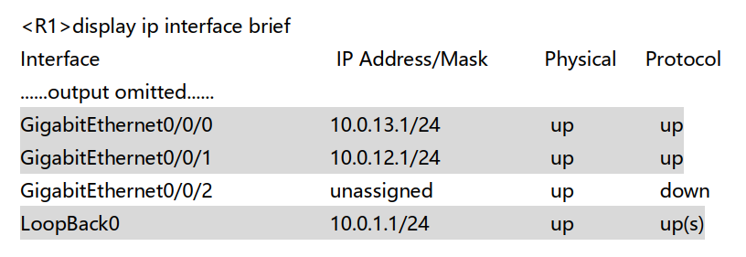
Perform basic system and
IP address configuration
Run the display current-configuration command to check the configuration

Slide 7
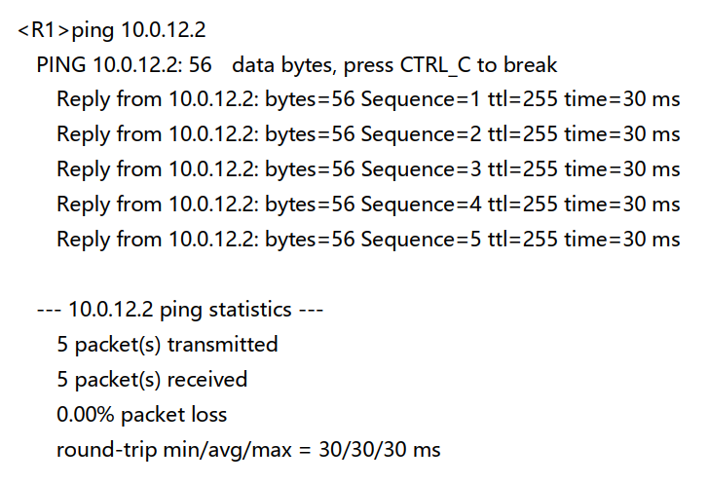
Perform basic system and
IP address configuration
Use the ping command to test network connectivity from R1
Ping 10.0.12.2
Ping 10.0.13.3

Slide 8
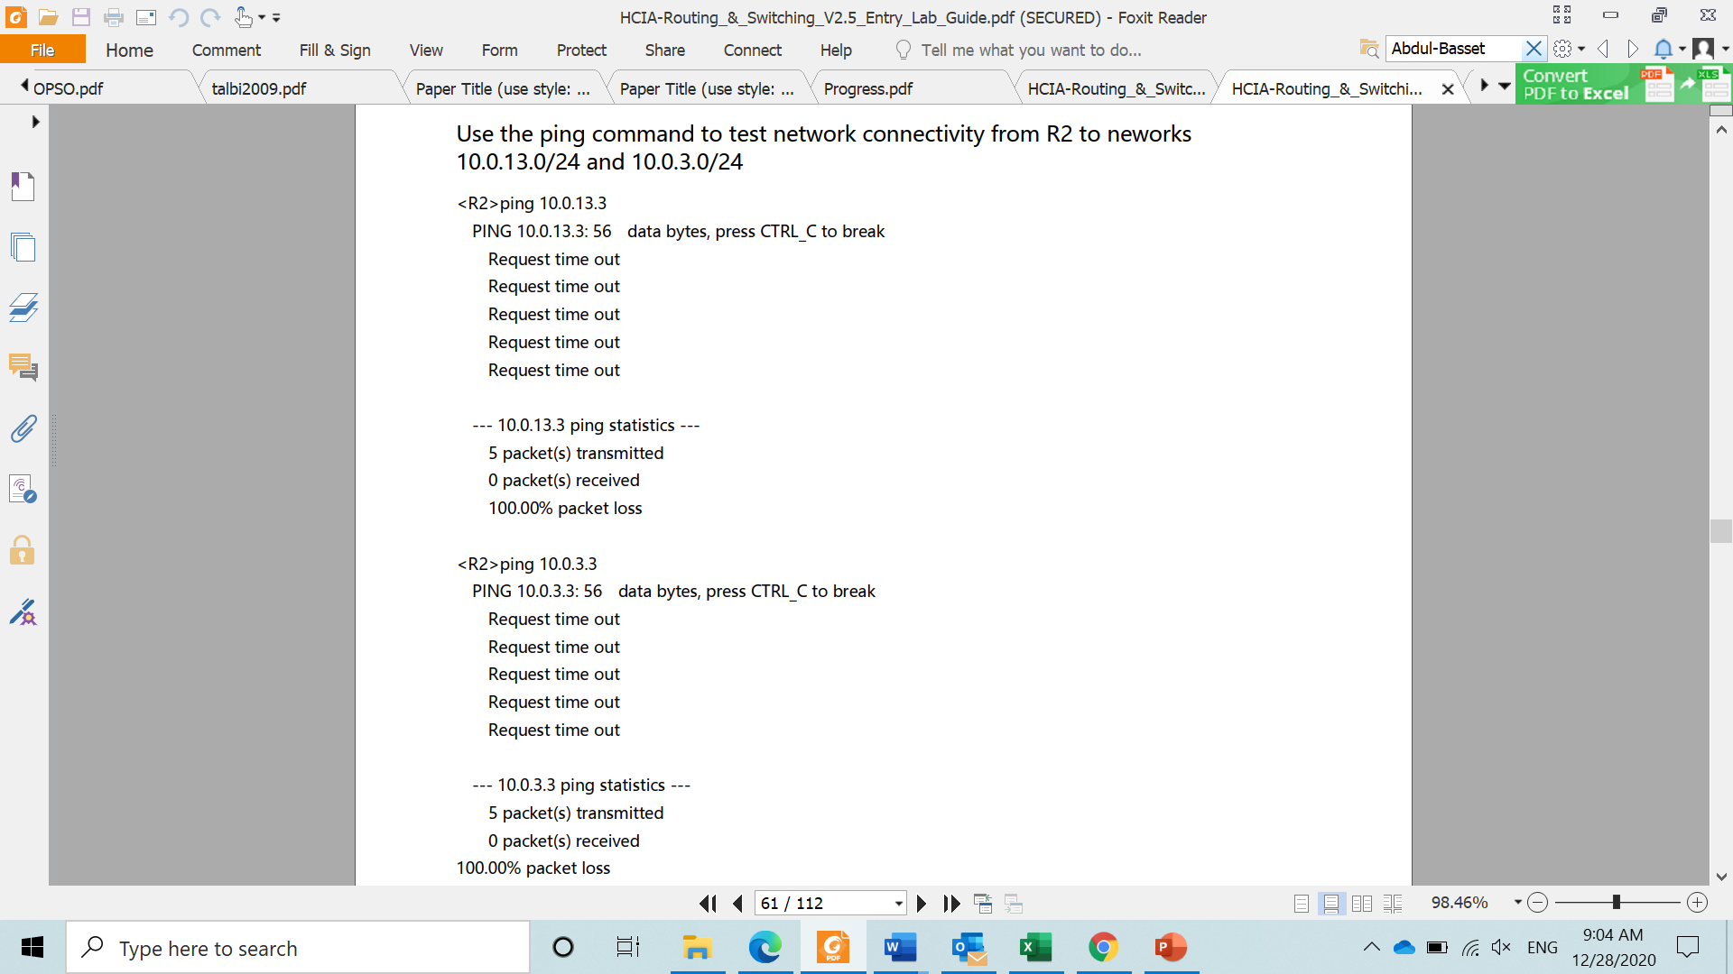
Test connectivity
Use the ping command to test network connectivity from R2 to networks 10.0.13.0/24 and 10.0.3.0/24

Slide 9
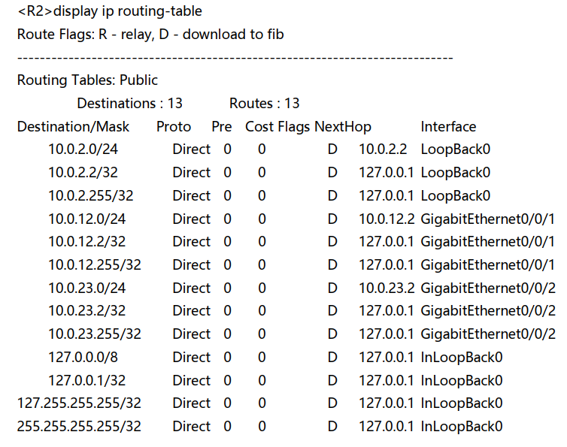
Test connectivity
Run the display ip routing-table command to view the routing table of R2.
The routing table does not contain the routes of the two networks.

Slide 10
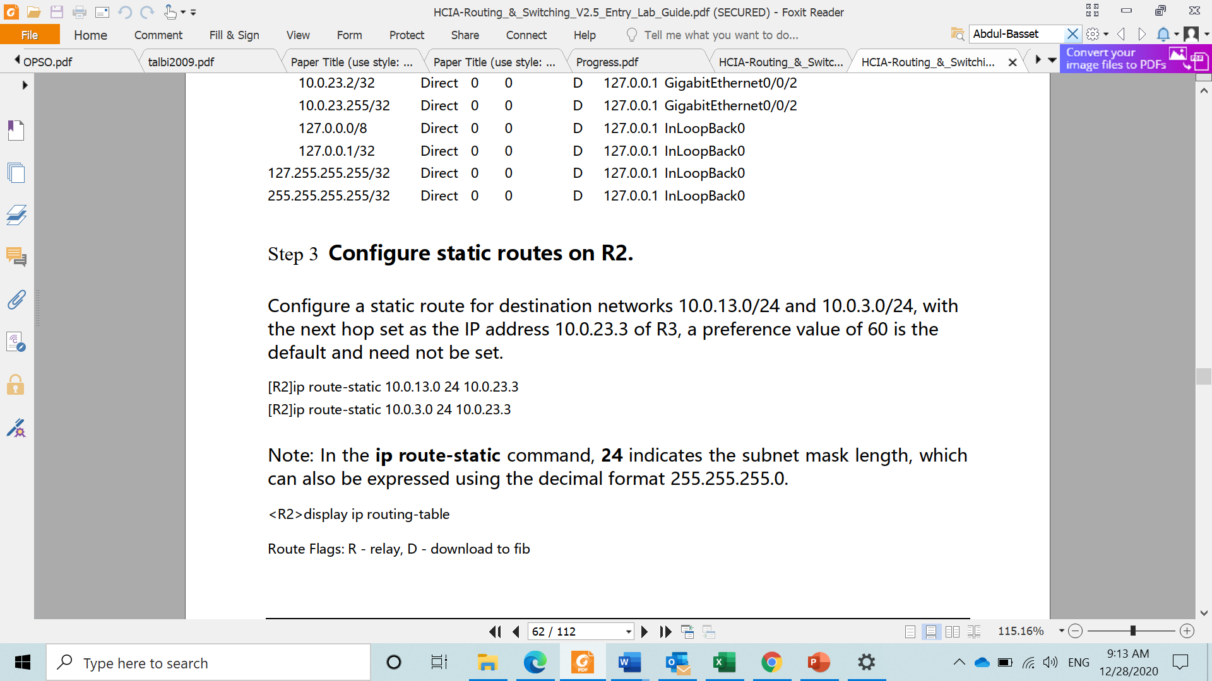
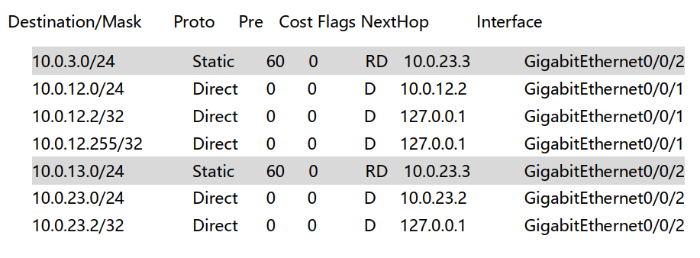
Configure static routes on R2
Configure a static route for destination networks 10.0.13.0/24 and 10.0.3.0/24, with the next hop set as the IP address 10.0.23.3 of R3, a preference value of 60 is the default and need not be set.
NOTE: in the ip route-static command, 24 indicates the subnet mask length, which can also be expressed using decimal format 255.255.25.0

Slide 11
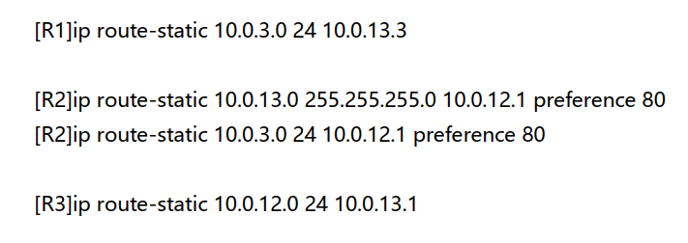
Configure backup static routes
The data exchanged between R2 and 10.0.13.3 and 10.0.3.3 is transmitted through the link between R2 and R3 fails to communicate with 10.0.13.3 and 10.0.3.3 if the link between R2 and R3 is faulty.
A backup static routes can be configured to enable this redundancy.
Amend the preferences for the backup static route to ensure that the routes are used only when the primary link fails.

Slide 12
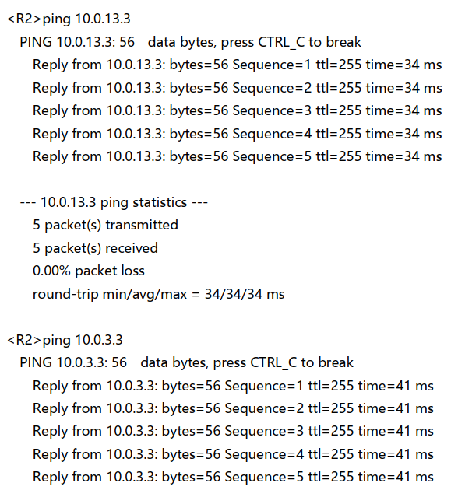
Test the static routes
Test network connectivity to ensure the route between R2 and R3 exists.

Slide 13
Thank you

